Slide 1
Defaultdict in Python
DVT101 – Lecture 34
- By Dataverse Tutorials

Slide 2
What is defaultdict?
Subclass of dict from collections
Auto-creates missing keys
Avoids KeyError
Default value mechanism

Slide 3
Why defaultdict is Needed
No manual key checks
Cleaner logic
Faster grouping & counting
Error-free access

Slide 4
How defaultdict Works Internally
Uses default_factory callable
missing mechanism
On-demand key creation
Lazy initialization

Slide 5
Default Factory Concept
Callable generator
list, int, str, set, custom
None behavior
Value auto-generation

Slide 6
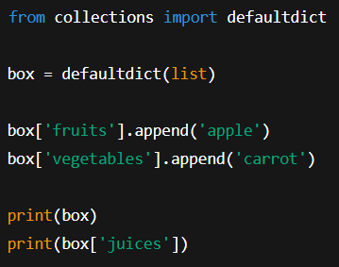
Basic Creation
Import from collections
Assign default factory
Auto key creation
Memory behavior

Slide 7
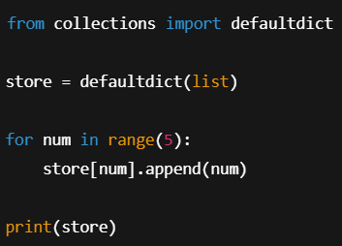
Using list as Factory
Auto empty list per key
Appending without checks
Grouping use-cases

Slide 8
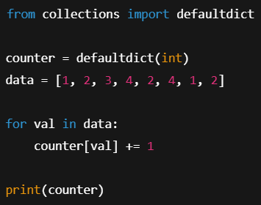
Using int as Factory
Default zero
Frequency counters
Histograms

Slide 9
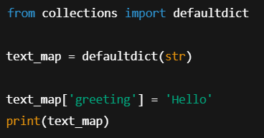
Using str as Factory
Default empty string
Safe concatenation
Text aggregation

Slide 10
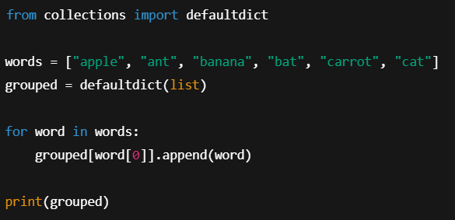
Grouping by Keys
Word classification
First-letter grouping
Categorization logic

Slide 11
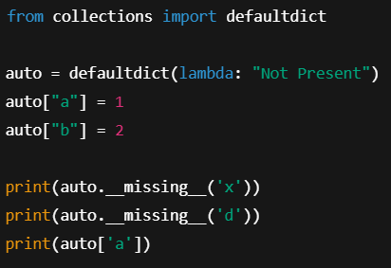
Behind the Scenes
Trigger on absent key
Calls default_factory
Error if None

Slide 12
dict vs defaultdict
Error vs default
Cleaner code
Performance difference

Slide 13
Real-World Industry Use
Log aggregation
Graph adjacency lists
Caching systems

Slide 14
Common Mistakes
Misusing missing
Wrong factory
Overwriting keys

Slide 15
Best Practices
Choose correct factory
Avoid None when needed
Use for dynamic data

Slide 16
Limitations
Slight overhead
Unexpected key creation
Debug complexity

Slide 17
Performance Considerations
Faster than manual checks
Slight memory cost
Suitable for large data

Slide 18
When NOT to Use
Static keys
Strict schemas
Security-sensitive data

Slide 19
Comparison with Counter
Counting vs grouping
Different use-cases
Complementary tools

Slide 20
Data Science Use Cases
Feature grouping
Token frequency
Graph edges

Slide 21
Summary & Key Takeaways
Auto-default dictionary
Simplifies code
Powerful grouping tool

Slide 22


